Slide 1




AI Research
F24-2 Sprint Demo
`
© Conestoga College. All rights reserved.

Slide 2

Team
Copilot Studio | Tech
Arsh Chauhan | Hamna Ashraf
Paras Rupani | Wei-Hsiang Chen
 | Jongeon Lee

Slide 3
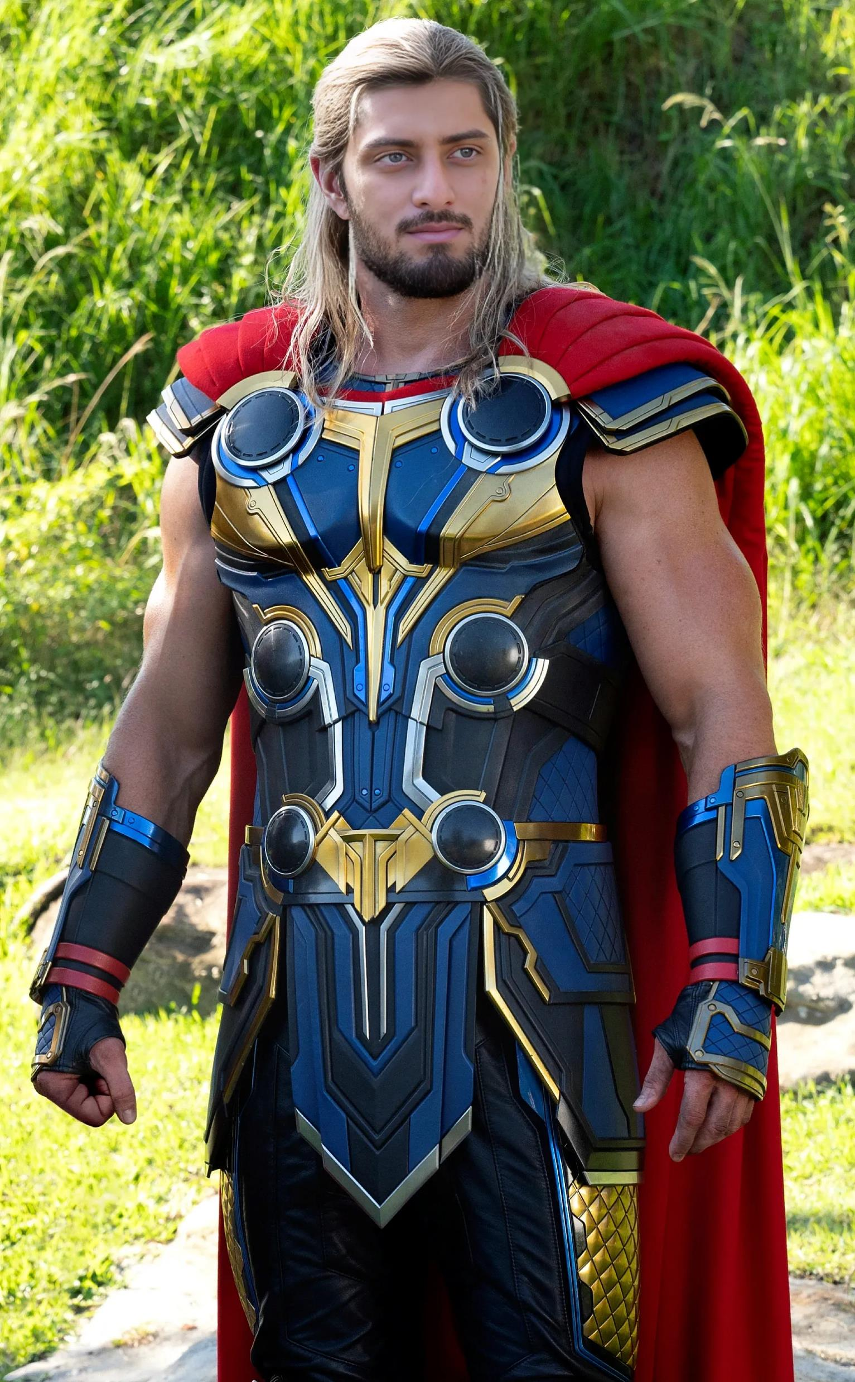




AI Team
Arsh
Paras
Wei
Hamna
Jongeon

Slide 4

Sprint Goal
Gathered and consolidated data from all team members to develop a functional chatbot.
Analyzed and refactored existing code for improved performance and clarity.
Fine-tuned the instructional plan data, removing noise for better accuracy

Slide 5
Demo time
Scenarios
Retrieving information through the chatbot.
Qualifications
User boundary test

Slide 6
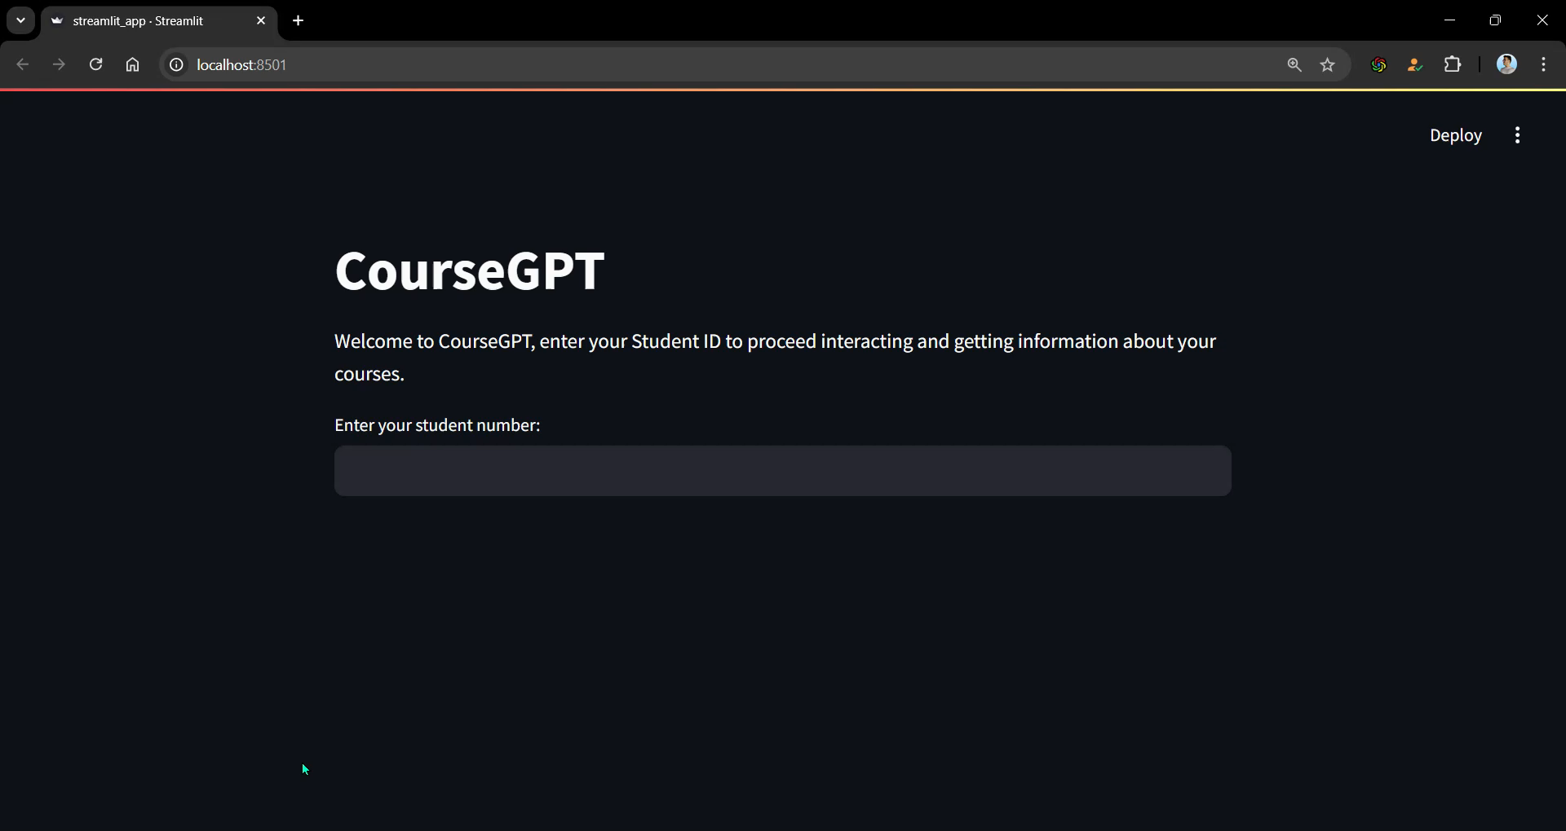

Slide 7
Blockers
Data Normalization
Difficulties in standardizing data formats.
Slow Response Time
With the initial approach, queries took longer time than expected
: Solution - Groq and a different Ollama model helped improve speed
Suboptimal Responses:
Initial outputs were unsatisfactory
: Solution - Modified prompts for better results.
Limited Studio Licenses:
No full access to Copilot Studio licenses.

Slide 8
Next Plan
Research multiple data formats that are easier for the model to process and improve its overall understanding.
Plan and design a system to store chat history for enhanced model accuracy and personalized responses
Improve Chatbot’s NLP abilities to increase its ability to answer more diverse user questions.

Slide 9
Q & A

